Slide 1


Hearts, minds and hands – leadership model
Larry Anderson / Ron Oslin
One System One Voice

Slide 2
Our Dance Card
Current Statistics
Wisdoms about Change
Facilitating Change
Combining Leadership Maturity and Stages of Change
The ”Righting Reflex”
Conversation Methodologies
Where/How to learn more

Slide 3
These statistics should cause each of us to question Our Assumptions about the processes we use to facilitate change
97% of all transformations Fail
90% of individuals will relapse and try to return to the before change condition
50% associates are not engaged
88% of associates don’t have passion for their work
80% of senior managers are not passionate about their work
We have been doing the same thing over and over again and expect a different result – It is time for a change

Slide 4
The burning question we here constantly is:
Why do people resist change and how do we get them to change and engage their hearts and minds?

Slide 5
Our two hypothesis I would like to share with you and ask you to consider are:
The classic methods leaders, trainers and coaches use are creating more resistance and lowering the rate of real change for people in the “Do Not Get It” and the “Not On Board” stages of change
The classic methods leaders, trainers, and coaches use for people in the “Do Not Get It” and the “Not On Board” stages of change cause compliance not real change

Slide 6
We must consider the differences between real change vs the illusion of change
Behavioral Change
Maintains new behavior under stress
Words, Actions and Body Language congruent
Maintains new behavior when external stimuli are removed
Beliefs changed
Assumptions changed
Intrinsic reward replacement
Compliance
Behavior dependent upon setting
Words, Action & Body Language inconsistent
Maintains new behavior as long as external stimuli are maintained
Behavioral change = upfront investment / Compliance = ongoing cost

Slide 7
Our Dance Card
Current Statistics
Wisdoms about Change
Facilitating Change
Combining Leadership Maturity and Stages of Change
The ”Righting Reflex”
Conversation Methodologies
Where/How to learn more

Slide 8
Five Wisdoms from the
Clinical Community
Our focus for today

Slide 9
A large percentage of people in an organization are:
Wisdom 1
“Addicted to the Status Quo”©
Addiction is defined as:
a state defined by compulsive engagement in rewarding stimuli, despite consequences. The term has little or no pejorative meaning attached to it.
Examples:
A business implements a new state of the art computer system and within months the reports and in some cases the screens look like the old system
A team improves their process and moves the furniture and within months things are back or almost the same as before the change
Trainers, coaches and leaders acknowledge the method they use is ineffective and continue to employee the same method
Notes:
Not all addictions to status quo are bad! For example: Maintaining a safe environment is good!
Do a quick reflection, what in your business are examples of maintaining the status quo when status quo should be let go! Why are we holding on?

Slide 10
Wisdom 2
No Person Can Change Another Person!
Notes:
Audience exercise – All who disagree with this statement please raise your hand
Hands Down
All who agree please raise your hand.
discuss why this statement is a fundamental TRUTH in the theory of change management

Slide 11
Wisdom 3
No Person Can Motivate Another Person!

Slide 12



If our expectation is Behavioral Change we must change our approach to “Change Management”
Wisdom 4
We must learn how to approach
change from a different perspective
Historic Approach:
Traditional Coaching,
Socratic Method, etc.
Unquestioned Assumptions
Beliefs
Behaviors
Actions
Results
My Known Truths
What I think is true of the environment
Range of actions observed by others
Specific activity observed by others
Qualitative and Quantitative
Insanity – Continuing to do the same thing expecting different results

Slide 13
There are two types of development/change and before we attempt change we must know what type of change we seek from ourselves and others
Wisdom 5
Horizontal (Growth)
  Skill
Vertical (Transformation)
  Thinking
Stage Regression (Fallback)

Slide 14
Our Dance Card
Current Statistics
Wisdoms about Change
Facilitating Change
Combining Leadership Maturity and Stages of Change
The ”Righting Reflex”
Conversation Methodologies
Where/How to learn more

Slide 15
Before we can help another person or ourselves change/develop we must understand where we and they are related to:
“Readiness to Change” and “Stage of Leadership Maturity”
Notes:
Audience exercise – All who disagree with this statement please raise your hand
Hands Down
All who agree please raise your hand.
discuss why this statement is a fundamental TRUTH in the theory of change management

Slide 16
Stages of readiness to Change
Do Not Get It /
Apathetic
Not on board /
Ambivalent
Supportive
Engaged
Adopter
Pre-contemplation
Contemplation
Preparation
Action
Maintenance
People in Pre-contemplation stage have no intention of changing their behavior for the foreseeable future
The person is aware a need to change exists and seriously considers, action, but has not yet made a commitment to an action
The person is intent upon taking action soon and often talks about steps in that direction
The person actively modifies their behavior, experiences and environment in order to overcome the problem
The person has made a sustained change wherein a new pattern of behavior has replaced the old. Behavior is firmly established

Slide 17
Typical Employee Segmentation for most changes
Action
(Engaged)
Maintenance
(Adopter)
Apathetic
Precontemplation
(Do Not Get It)
Preparation
(Supportive)
Data is based on several research studies

Slide 18
Typical Employee Segmentation
Action
(Engaged)
Maintenance
(Adopter)
Preparation
(Supportive)
The classical coaching methods change agents are taught and use can be effective in these segments to lower resistance and increase change
Classical Coaching is effective for 25% of the population
Data is based on several research studies

Slide 19



Nine Stages of Leadership Maturity
IMPULSIVE
SELF-CENTRIC
GROUP-CENTRIC
SKILL-CENTRIC
SELF-DETERMINING
UNITIVE
SELF-QUESTIONING
CONSTRUCT-AWARE
SELF-ACTUALIZING
Graphic from Dr. Cook-Greuter

Slide 20





Tiers of Development
Postconventional
Conventional
Pretconventional

Slide 21
Conventional Stages
IMPULSIVE
SELF-CENTRIC
GROUP-CENTRIC
78%
11% | GROUP-CENTRIC (3)
37% | SKILL-CENTRIC (3/4)
30% | SELF-DETERMINING (4)
SKILL-CENTRIC
SELF-DETERMINING
UNITIVE
SELF-QUESTIONING
CONSTRUCT-AWARE
SELF-ACTUALIZING
78% of leaders are in Stage 3, 3 / 4, & 4
© Barbara Braham, Ph.D., 2016

Slide 22
Postconventional Stages
IMPULSIVE
SELF-CENTRIC
GROUP-CENTRIC
11% | SELF-QUESTIONING (4/5)
5% | SELF-ACTUALIZING (5)
1% | CONSTRUCT-AWARE (5/6)
1% | UNITIVE (6)
SKILL-CENTRIC
SELF-DETERMINING
UNITIVE
SELF-QUESTIONING
CONSTRUCT-AWARE
SELF-ACTUALIZING
While few leaders reach postconventional stages (based on an ‘n’ of approximately 15,000), research performed by Bob Anderson of the Leadership Circle and Susanne Cook-Greuter shows a correlation between highly positive business results and organizations led by visible leaders who are at stage (5).
© Barbara Braham, Ph.D., 2016

Slide 23

Group-Centric Meaning Making
Conventional
Stage
Seek to belong to the group
Strive to keep relationships friendly and smooth
Loyalty is a value
Important to save face
Power comes from affiliation
“Us” and “them”
Concerned about today

Slide 24

Skill-Centric Meaning Making
Conventional
Stage
Want to stand out and be unique
Perfectionist standards, have the answers
Difficult to prioritize, tendency to micromanage
Yes, but…
Sarcastic humor
Specialist, “craft logic”
Somewhat feedback averse
Short time horizons
Truth is known - See only right or wrong

Slide 25
Skill-Centric Meaning Making
Common concerns of leaders at this stage
Conventional
Stage
Time management – efficiency
Being “right” and getting others to see that they are right
Being perceived as a “Go To” person
Looking good to others (self-consciousness)
Being outed or left out
Uncomfortable with ambiguity
Concerned about this week/month

Slide 26

Skill-Centric Meaning Making
Common concerns of leaders at this stage
Conventional
Stage
Getting sufficient “direction” from those above them
Receiving “accurate” work from others
Practical, concrete concerns

Slide 27

Self-Determining Meaning Making
Conventional
Stage
Focus on successful plans and outcomes
Pursue results and effectiveness rather than efficiency only
Driven to achieve
Capable of prioritizing
Sees self forward and backwards in time (causality)
Belief in scientific method
Can collaborate by “agreeing to disagree”
Open to feedback that will help them achieve their goals
Truth can be found through appropriate scientific methods
Thinks about this quarter or half year

Slide 28
Self-Determining Meaning Making
Common concerns of leaders at this stage
Conventional
Stage
Time management – how to manage multiple priorities
Delegation
Influencing and persuading others
Self-awareness
How to “be their best”, feel gilt when not meeting own standards or goals
Making choices
Finding “the” answer
Managing stress and work/life balance
Building high performing teams and workplaces

Slide 29

Self-Questioning Meaning Making
4th Person Perspective
Postconventional
Stage
See self in relationships to context
Concerned with difference between reality and appearance
Understanding of systemic connections and unintended consequences of actions
Aware of impact of action on others
Begin to question own assumptions
Realize subjectivity of beliefs
4th Person Perspective allows individuals to examine how they came to believe what they believe and feel and how one knows and proves things

Slide 30
Self-Questioning Meaning Making
Postconventional
Stage
Talk of interpretations rather than truth – truth can not be found – everything is relative
Can play different roles in different contexts
Systematic and double-loop problem solving (concerned with defining the problem)
Listen to every voice, honor all ideas equally
Begin to seek out and value feedback for its own sake
Thinks about 1 – 2+ years

Slide 31

Self-Actualizing Meaning Making
Postconventional
Stage
Historical perspective, lifetime view
Recognize higher principles
Recognize complexity and dynamic systems interactions
Interested in the interplay of roles, theory, context, judgement, not just rules and customs
Links theory and principles with practice
Process and goal oriented

Slide 32
Self-Actualizing Meaning Making
Postconventional
Stage
Aware of paradox and contradiction in system and self
Deep tolerance of others
Creator of ”positive-sum” games
Seek feedback form others and the environment as vital for growth and making sense of the world
Non-hostile humor

Slide 33
Exercise #1: Assessing yourself and others
Speaker: Think of something you have been wanting to do, would like to do but have not done anything toward accomplishing
Using the readiness to change scale rate yourself on your readiness to change and accomplish the item you described above
Using the Stages of Leadership Maturity Model select a tier that best describes you in your normal state
Discuss with your Listener why you selected the what you did
Listener: Listen intently and make your own determination of the speaker’s readiness to change and stage of leadership maturity
Discuss with the speaker your thoughts

Slide 34
Group discussion
Discuss insights

Slide 35
Our Dance Card
Current Statistics
Wisdoms about Change
Facilitating Change
Combining Leadership Maturity and Stages of Change
The ”Righting Reflex”
Conversation Methodologies
Where/How to learn more

Slide 36


Effective coaching engagements require the coach to know themselves and their coachee
?
?
Stage of Leadership Maturity
78%
Preparation
Action
Contemplative
Maintenance
Pre-contemplative
70%
Stage of Readiness to Change
Relative position is important not location

Slide 37
Effective coaching engagements require the coach to know themselves and their coachee
Senior Leaders
Stage of Leadership Maturity
78%
Associates &
Junior Leaders
Preparation
Action
Contemplative
Maintenance
Pre-contemplative
70%
Stage of Readiness to Change
Relative position is important not location

Slide 38
Effective coaching to change thinking means adjusting the coaching methodology and conversation style to meet the needs of the coachee
Construct challenging methodology
Motivational Interviewing conversation style
Construct challenging methodology
Socratic / Humble Inquiry conversation style
Postconventional
Stage of Leadership Maturity
Sharing insight methodology
Motivational Interviewing conversation style
Sharing insight methodology
Instructional conversation style
Conventional
Preparation
Action
Pre-contemplative
Contemplative
Maintenance
Stage of Readiness to Change
Meet the needs of the coachee NOT the coach

Slide 39
Exercise #2: Assessing yourself and others
Speaker and Listener working together:
Craft two or three questions or statements that will offer you insight as to the anchor stage of leadership maturity another person is in.
Must be large type on flip chart paper so all can see.
All Dyads report out

Slide 40
Larry and Ron’s list of questions and statements
Who is the customer of the fine/great work you do? The response gives insight about the SCOPE the person considers important.
How do you approach problems? The response gives insight about whether they are a single or double-loop thinker and tells about their systematic thinking ability.
It appears you have a good process here. How does it work for you? Gives insight to their time horizon, process appreciation, goals, and efficiency vs effectiveness.
Tell me about your upcoming vacation. Give insight about planning, and time horizon.
Tell about some recent feedback you or your team received. Gives insight about how they think about feedback.

Slide 41
Exercise #3: Assessing others
Form Triads:
Speaker: Talk about something you are struggling with in your work life
Listener: Access the Speakers' stage of leadership maturity using a max of 3 Questions and or statements created in the previous exercise.
Observer: Start timing Listener once Listener ask the 1st question or makes the first statement and stop exercise after 3 minutes.
Listener: Describe your assessment to the Speaker and discuss accuracy
Switch roles and repeat

Slide 42
Group discussion
Discuss insights

Slide 43
Our Dance Card
Current Statistics
Wisdoms about Change
Facilitating Change
Combining Leadership Maturity and Stages of Change
The ”Righting Reflex”
Conversation Methodologies
Where/How to learn more

Slide 44

This is the typical interaction leaders have when trying to bring about change
Leader
(Speaker)
Person Struggling with Change
(Listener)
This is referred to as the “Righting Reflex”

Slide 45

To support genuine change we must be willing to swap roles
Leader
(Listener)
Person Struggling with Change
(Speaker)
It is the Speaker’s responsibility to resolve their struggle

Slide 46
Our Dance Card
Current Statistics
Wisdoms about Change
Facilitating Change
Combining Leadership Maturity and Stages of Change
The ”Righting Reflex”
Conversation Methodologies
Where/How to learn more

Slide 47
Effective coaching to change thinking means adjusting the coaching methodology and conversation style to meet the needs of the coachee
Construct challenging methodology
Motivational Interviewing conversation style
Construct challenging methodology
Socratic / Humble Inquiry conversation style
Postconventional
Stage of Leadership Maturity
Sharing insight methodology
Motivational Interviewing conversation style
Sharing insight methodology
Instructional conversation style
Conventional
Preparation
Action
Pre-contemplative
Contemplative
Maintenance
Stage of Readiness to Change
Meet the needs of the coachee NOT the coach

Slide 48
Slide describing Construct Challenging Methodology
Construct Challenging Methodology is a conversation that assists the listener to breakdown the “construct” to its principles and re-engineer a new “construct” that fulfills the principles.
Assist the listener in understanding the current ”construct”
Assist the listener to defined the principles that must be followed
Assist listener to determine long term (3-5+ yr) outcome expectations

Slide 49
Effective coaching to change thinking means adjusting the coaching methodology and conversation style to meet the needs of the coachee
Construct challenging methodology
Motivational Interviewing conversation style
Construct challenging methodology
Socratic / Humble Inquiry conversation style
Postconventional
Stage of Leadership Maturity
Sharing insight methodology
Motivational Interviewing conversation style
Sharing insight methodology
Instructional conversation style
Conventional
Preparation
Action
Pre-contemplative
Contemplative
Maintenance
Stage of Readiness to Change
Meet the needs of the coachee NOT the coach

Slide 50
Slide describing Insight Sharing Methodology
Insight Sharing Methodology is a conversation style that offers options that start the creative mind of the other person without shifting responsibility to the speaker
Provide in third party form
  “Some people in your situation find...”
  “Some clients decide...”
Provide at least three options
Ask client to draw conclusion about options
  “Any of these fit for you?”
  “Which of these seems most likely to work for you?”

Slide 51
Effective coaching to change thinking means adjusting the coaching methodology and conversation style to meet the needs of the coachee
Construct challenging methodology
Motivational Interviewing conversation style
Construct challenging methodology
Socratic / Humble Inquiry conversation style
Postconventional
Stage of Leadership Maturity
Sharing insight methodology
Motivational Interviewing conversation style
Sharing insight methodology
Instructional conversation style
Conventional
Preparation
Action
Pre-contemplative
Contemplative
Maintenance
Stage of Readiness to Change
Meet the needs of the coachee NOT the coach

Slide 52
Slide describing Motivational Interviewing (MI)
Motivational Interviewing is a person-centered conversation style for addressing the common problem of ambivalence about change
Five Principles of Motivational Interviewing
  Express empathy through reflective listening.
  Develop discrepancy between clients' goals or values and their current behavior.
  Avoid argument and direct confrontation.
  Adjust to client resistance rather than opposing it directly.
  Support self-efficacy and optimism
Remember the RULE: Resist the righting reflex; Understand the client’s own motivations; Listen with empathy; and Empower the client.

Slide 53
Speaker’s Topic
A Taste of MI: Conversation with one speaker and one listener
Something about yourself that you
  want to change
  need to change
  should change
  have been thinking about changing
but you haven’t changed yet
i.e. – something you’re ambivalent about
Notes:
53

Slide 54
Listener/Leader
Listen carefully with a goal of understanding the dilemma
Give no advice.
Ask these four open questions and listen with interest:
  Why would you want to make this change?
  How might you go about it, in order to succeed?
  What are the three best reasons to do it?
  On a scale from 0 to 10, how important would you say it is for you to make this change?
      Follow-up: And why are you at __ and not zero?
Give a short summary/reflection of the speaker’s motivations for change
Then ask: “So what do you think you’ll do?” and just listen
Notes:
54

Slide 55
Group discussion
Discuss insights

Slide 56
Four questions we would like you to ponder:
When I enter a coaching conversation do I assume they want to be coached?
When I speak am I trying to be interested or interesting?
When I ask a question is it for my understanding or to deepen theirs?
Is my objective compliance or behavioral change?

Slide 57
Experiments are yielding positive results
Where coach projects their needs on the coachee
Change adoption appears fast but is actually compliance
Leaders spending more time on oversight
Engagement scores drop
Turnover increases
Training cost rise
Where coach meets the coachee where they are:
Change adoption appears slower but is real adoption
Leaders spend less time and cost on oversight and more performing leadership
Engagement scores rise Turnover decreases
Training cost decrease

Slide 58
What Questions Do You Have?

Slide 59
Where are you in your readiness to Change?
Do Not Get It /
Apathetic
Not on board /
Ambivalent
Supportive
Engaged
Adopter
Pre-contemplation
Contemplation
Preparation
Action
Maintenance
People in Pre-contemplation stage have no intention of changing their behavior for the foreseeable future
The person is aware a need to change exists and seriously considers, action, but has not yet made a commitment to an action
The person is intent upon taking action soon and often talks about steps in that direction
The person actively modifies their behavior, experiences and environment in order to overcome the problem
The person has made a sustained change wherein a new pattern of behavior has replaced the old. Behavior is firmly established

Slide 60
Create Hands, Heart, and Mind Model on Flip Chart

Slide 61
Our Dance Card
Current Statistics
Wisdoms about Change
Facilitating Change
Combining Leadership Maturity and Stages of Change
The ”Righting Reflex”
Where/How to learn more

Slide 62
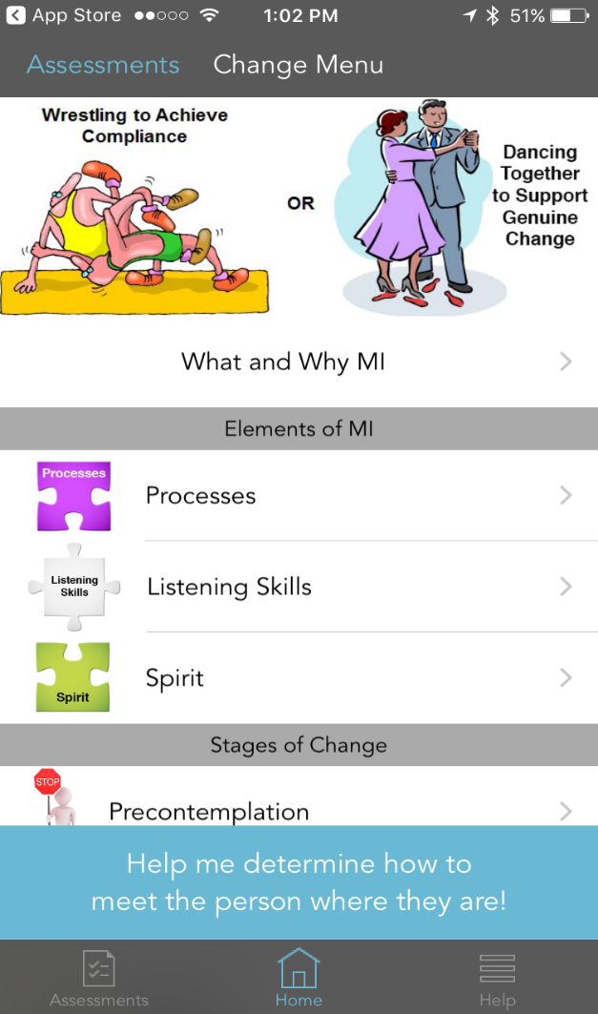

To assist people who are willing to embrace a different model we created an app: iPhone, iPad & Android title:
MI – Coach’s Helper to facilitate behavior change
If you choose to explore the app; our request is, send us your feedback so we can make it better!

Slide 63

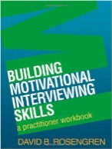

Reference Material Slide
http://www.onesystemonevoice.com
http://motivationalinterviewing.org/
Motivational Interviewing, Third Edition: Helping People Change (Applications of Motivational Interviewing) by William R. Miller and Stephen Rollnick
Building Motivational Interviewing Skills: A Practitioner Workbook (Applications of Motivational Interviewing) by David B. Rosengren (Jul 2, 2009)
Motivational Interviewing for Leadership: MI-LEAD by David Wilcox, Brian Kersh and Elizabeth Jenkins

Slide 64
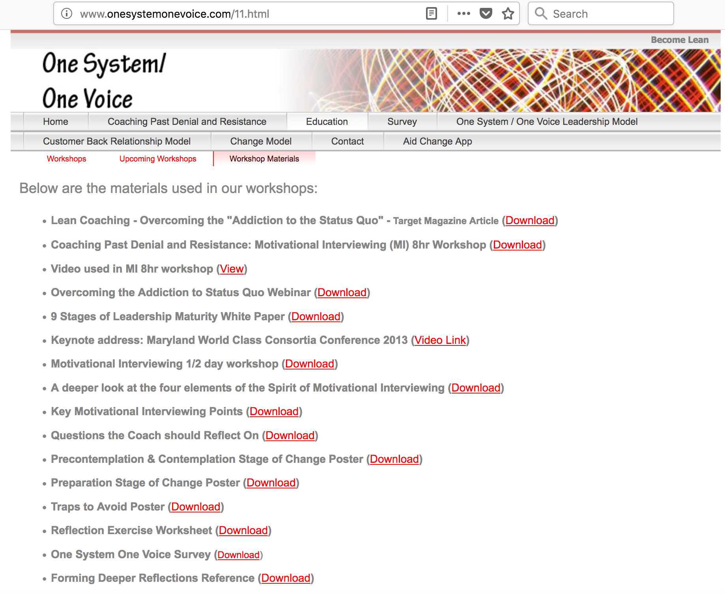

Slide 65
Thank You!
Your opinion is important to us!
Please take a moment to complete the survey using the conference mobile app.
Session No: MW/16
Hearts, minds and hands – leadership model
Larry Anderson / larry.anderson@onesystemonevoice.com
Ron Oslin / ron.oslin@onesystemonevoice.com
One System One Voice LLC

